Slide 1

MEDIA & THE PUBLIC
Week 3 Media coverage of politics
Ryan Wang
ryanyang@psu.edu

Slide 2
Why does (mass) media cover politics?

Slide 3
The function of (mass) media
A linkage institution between government and people
People → Government
Muckraking/Watchdog/Investigative journalism (e.g., Watergate)
Government → People
”Fireside chats”
Gatekeeping
Agenda-setting

Slide 4
What does (mass) media cover in term of politics?

Slide 5
News coverage of political issues (Aalberg , 2014)
Four distinct genres of presentation:
Thematic news frame:
It places the public issue in a general context and usually takes the form of an in-depth “background” report.
Episodic news frame:
It depicts issues in terms of individual instances or specific events.
Issues and policy news frame:
It focus on real-life conditions with relevance for issue positions
Strategic game news frame:
It focus on questions related to who is winning and losing, the performances of politicians and parties, and on campaign strategies and tactics.

Slide 6
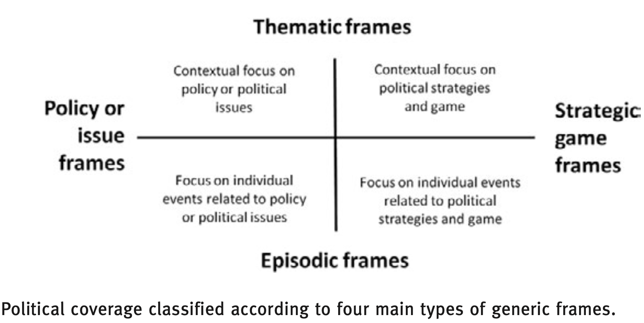
News coverage of political issues (Aalberg , 2014)

Slide 7
What types of (mass) media?

Slide 8
Typology of media outlet (Humprecht & Esser, 2016)
Private broadcasters
corporate-owned, strongly commercialized
Public broadcasters
financed by fees, public or state funds with a primary public service mission, and a low degree of commercialization
Corporate newspapers
owned by chain or stock exchange-listed company, strongly commercialized
Independent newspapers
alternative ownership form, moderate degree of commercialization
Popular newspapers
tabloid-style mass market, strongly commercialized
Made-for-Web news providers
either online-only pure player or – where nonexistent – online news provider with an independent profile and organizational structure

Slide 9
What news are we reading?

Slide 10
Algorithmic news/journalism
Machine-generated news
Natural language generation (Example: the Guardian)
Machine-driven news (Feezell et al., 2021)
User-driven algorithms
based on past selections and assumed preferences of the individual user and has no known social network-related input
Socially driven algorithms
news contents based on both the user as well as their network.

Slide 11
Algorithmic news/journalism
Machine-driven news (Feezell et al., 2021)
User-driven algorithms: emphasizes the personal attributes and biases of citizens rather than their ties to other citizens (e.g. YouTube).
Users more likely to see news that’s seemingly popular, homogeneous across outlets, eschews public affairs, emphasizes national and business news, opinion pieces.
Users see much narrower set of topics and perspectives.
Expose users to increasingly negative and opinion-reinforcing information.
Socially driven algorithms: it takes into account user’s activities on SNS, and their ties to others in their network (e.g. Facebook, Twitter)
Depends on the ideological characteristics of user’s networks.
Online network grows, information diversifies.
Potential echo chamber? (still under debate)
May lead to additional information seeking, mitigate polarization.
Notes:
User-driven algorithms example: One example of a user-driven algorithm is YouTube, which explicitly only draws on user demographics, location, watch and search history to recommend videos (Covington, Adams and Sargin 2012).
Socially driven algorithms: example: Facebook, for example, explicitly admits to using social connections in generating content recommendations – hence the “Friend A and 30 other friends like this” under so many posts (Kabiljo & Aleksandar Ilic, 2015).

